Slide 1



Welcomes you
in Skyworld
www.myskyworldonline.com

Slide 2
IMPORTANT INFORMATION
Switch off/ silent your mobile phone.
Do not leave your seat during the presentation
If you have any question , you can ask at the end of the presentation
www.myskyworldonline.com

Slide 3

LIVING COST
  - ₹10
  1960- ₹100
  1980- ₹1000
  2000- ₹10000
  2020- ₹100000
  2040- ₹1000000
www.myskyworldonline.com

Slide 4
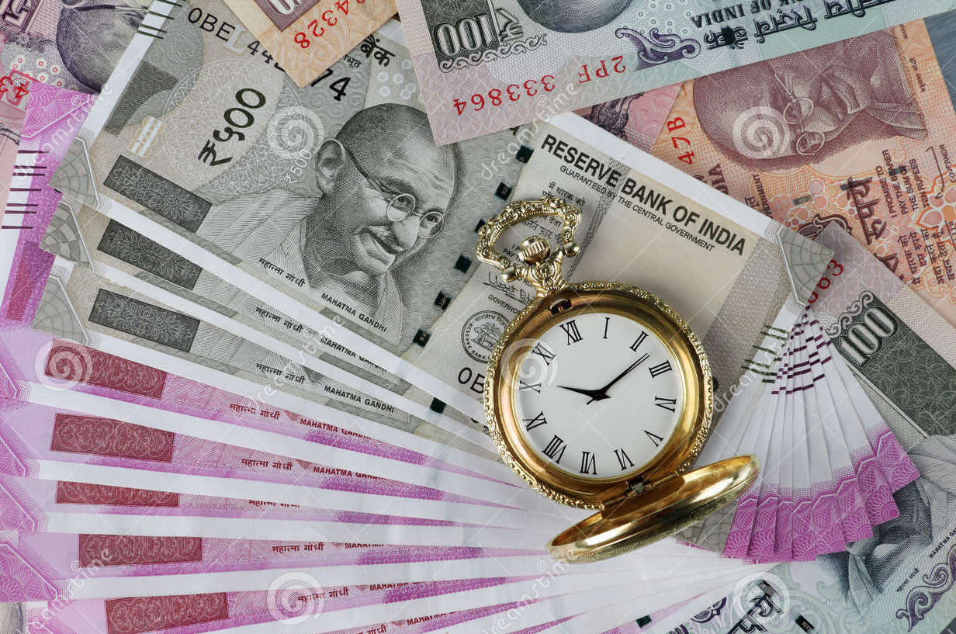
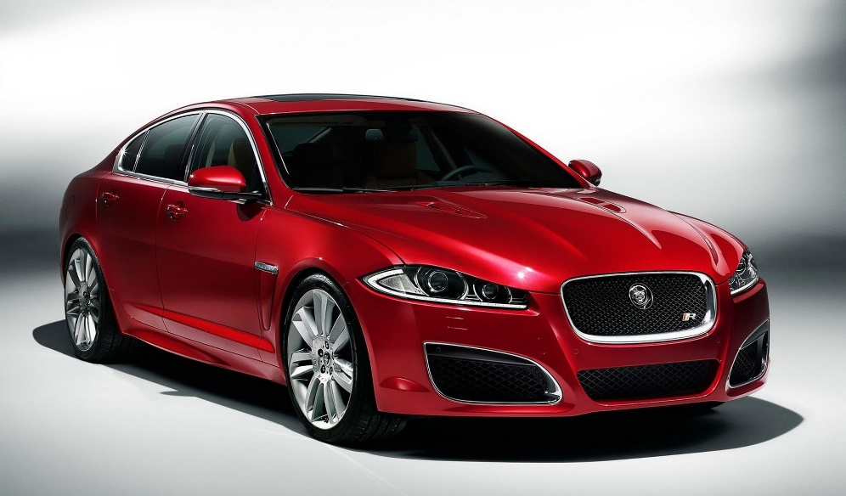
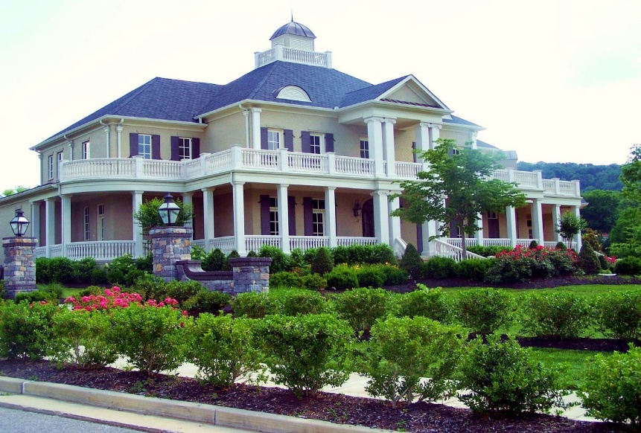


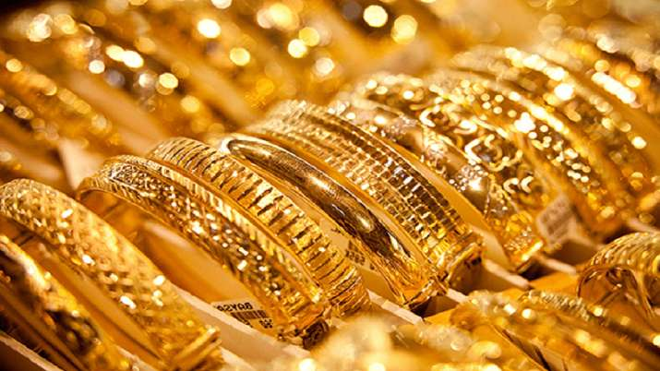
DREAMS OF LIFE
www.myskyworldonline.com

Slide 5

MARKET BRANDS
www.myskyworldonline.com

Slide 6
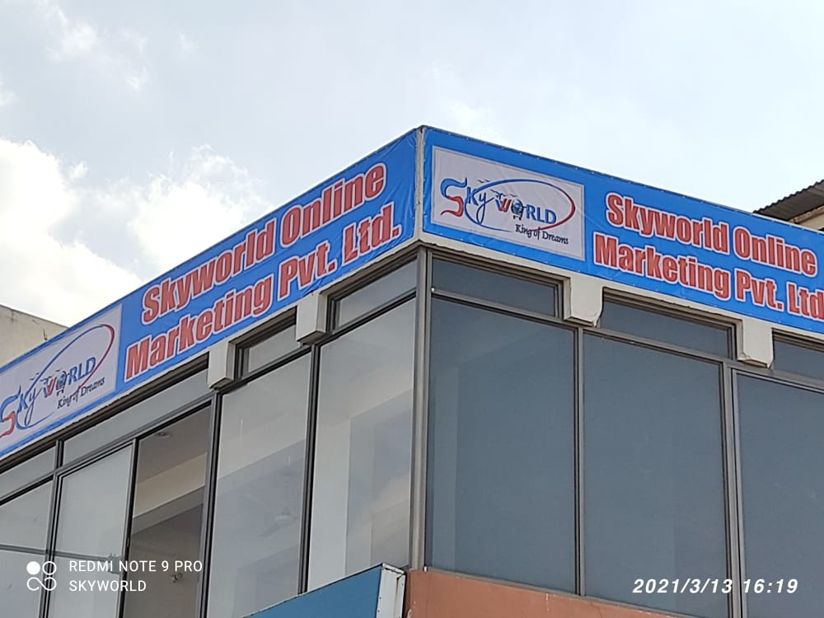

ESTD.
08 JANUARY 2021
Registered
Under Companies Act 1956 and 2013
1ST floor, Main Sikar road, Harmada Jaipur
Rajasthan
www.myskyworldonline.com

Slide 7
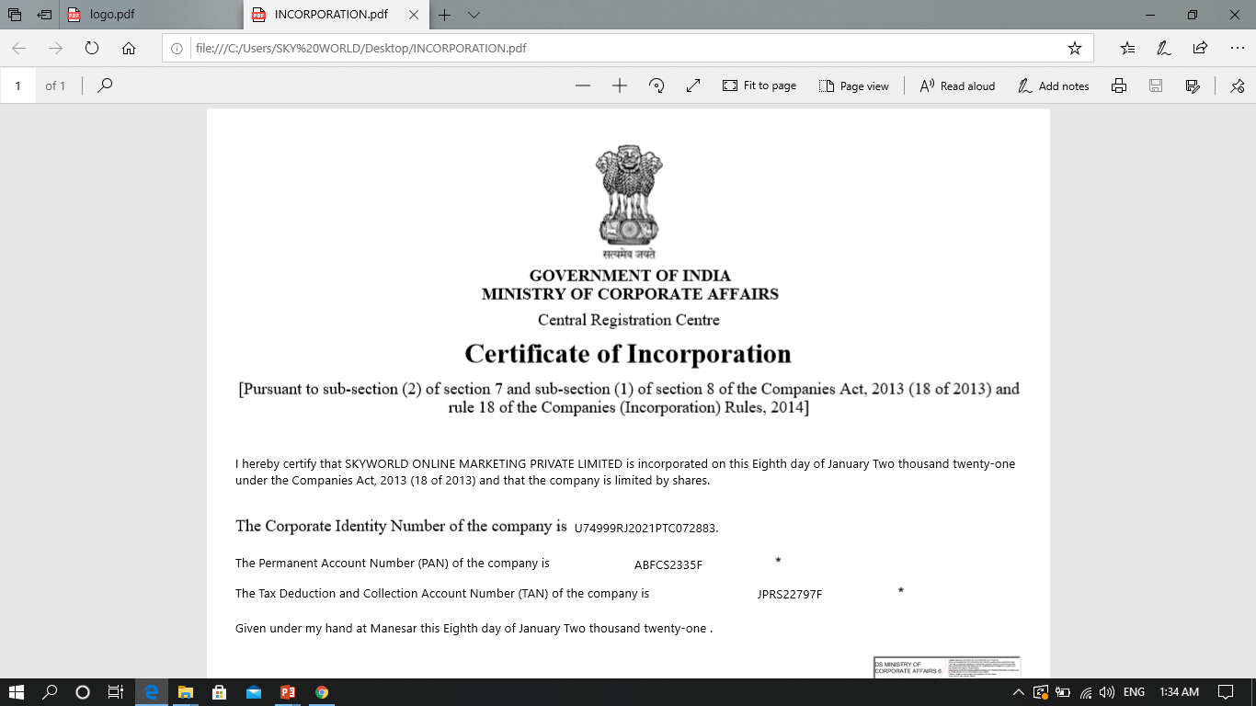
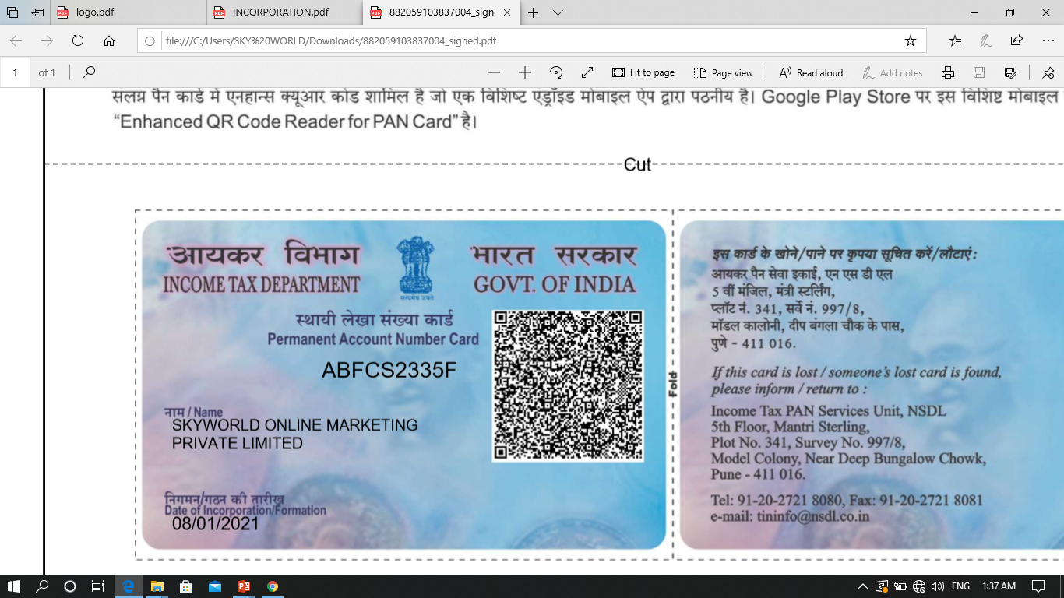
www.myskyworldonline.com

Slide 8
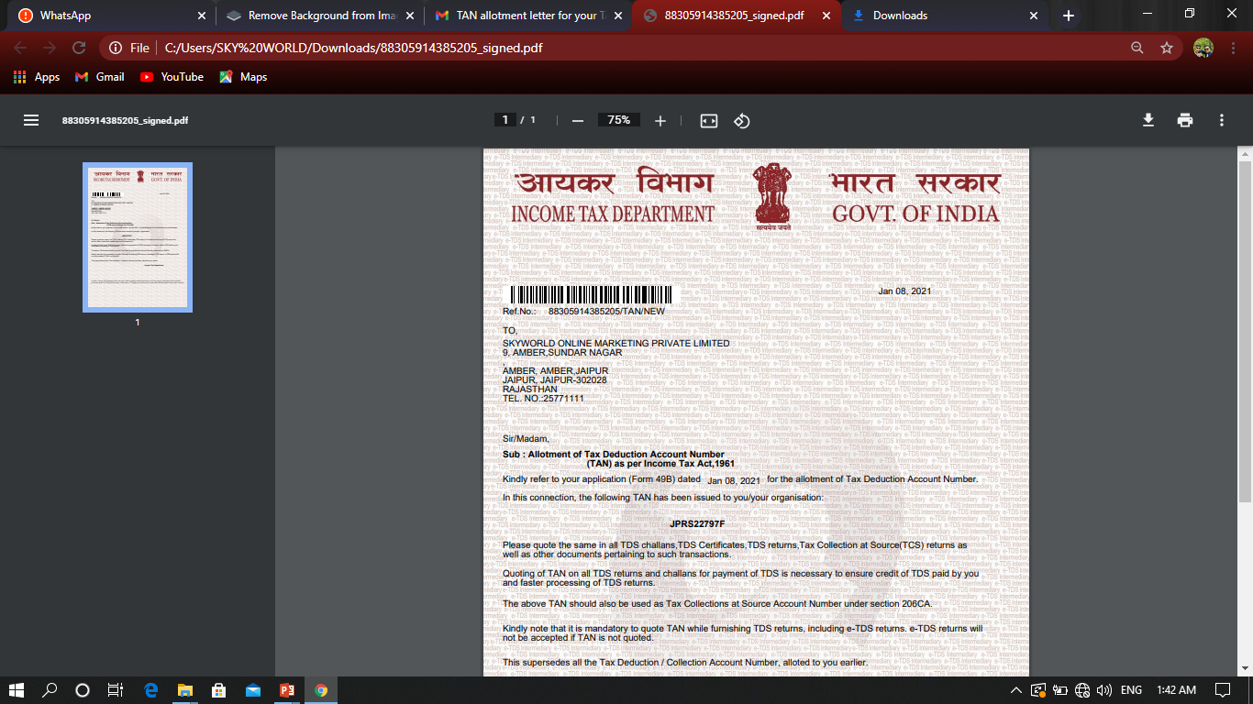
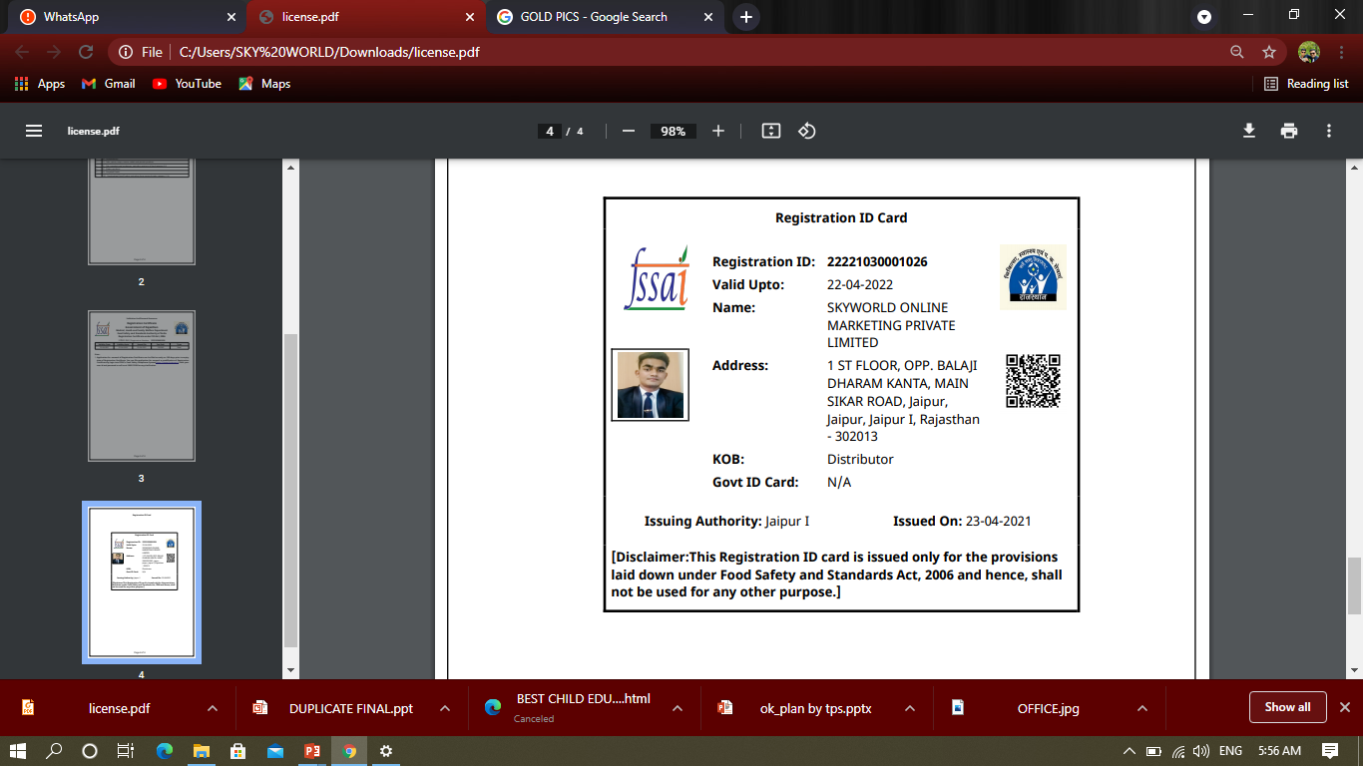
5
www.myskyworldonline.com

Slide 9



SHOPPING OPTIONS
RETAIL STORE
shop /mall etc
ON MRP
FACTORY
OUTLET
Discount on MRP
SKYWORLD
Discount on MRP
+
Commission
1- Just you have to make a decision for online shopping in SKYWORLD
2- And this is the best way to become rich
www.myskyworldonline.com

Slide 10
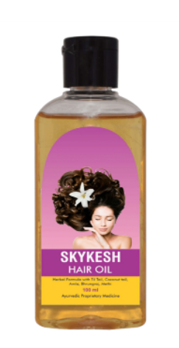
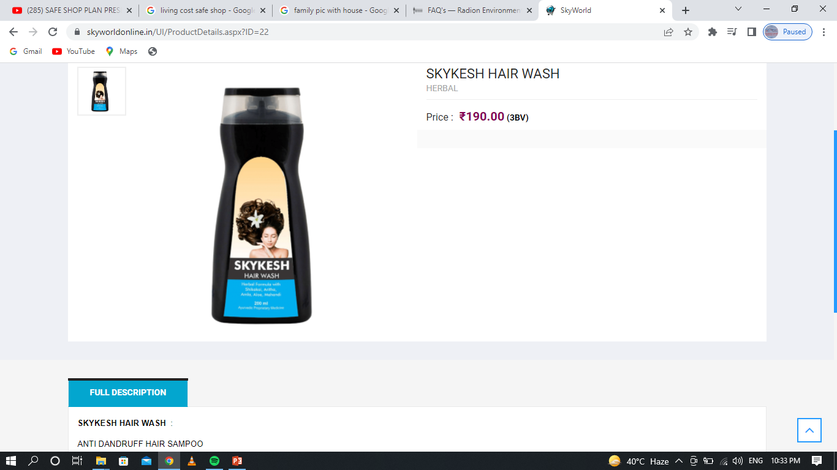
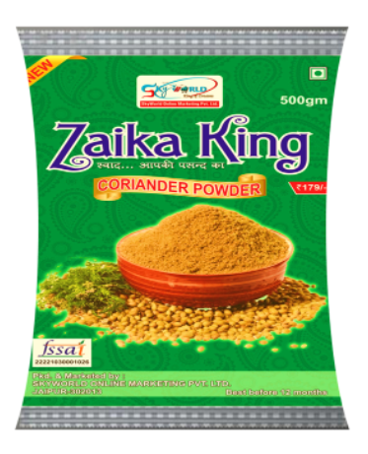
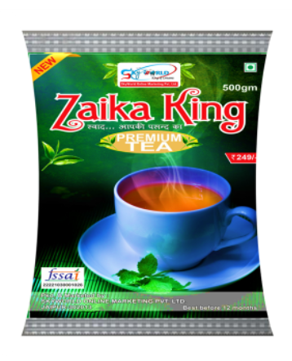
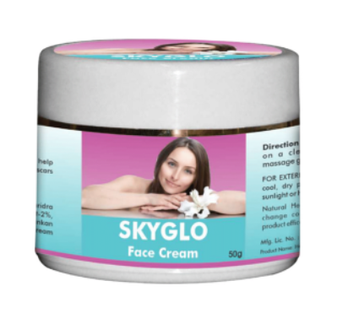
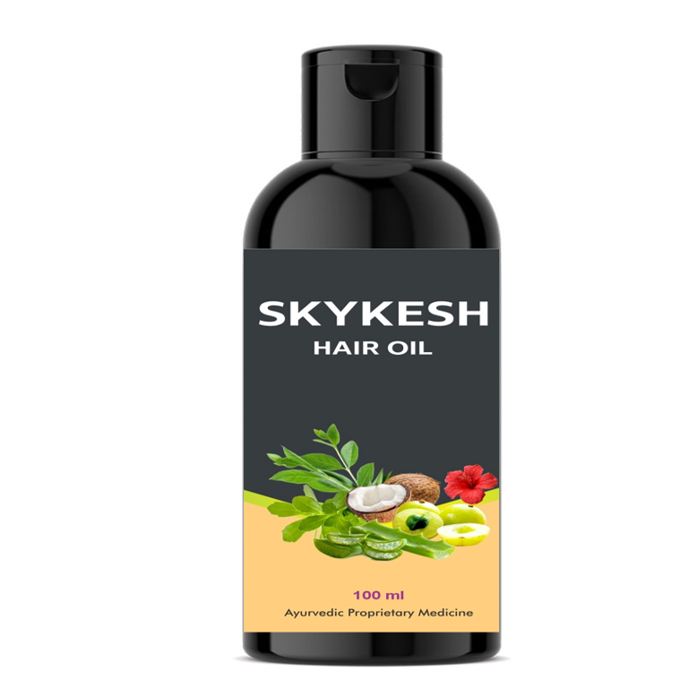

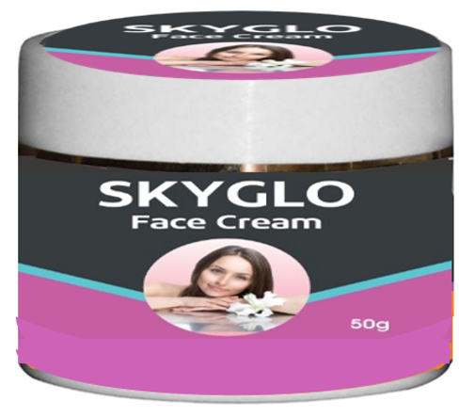
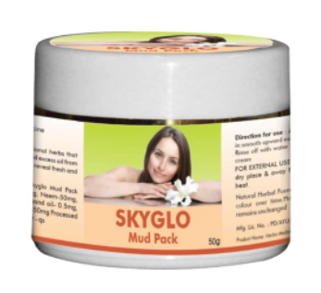
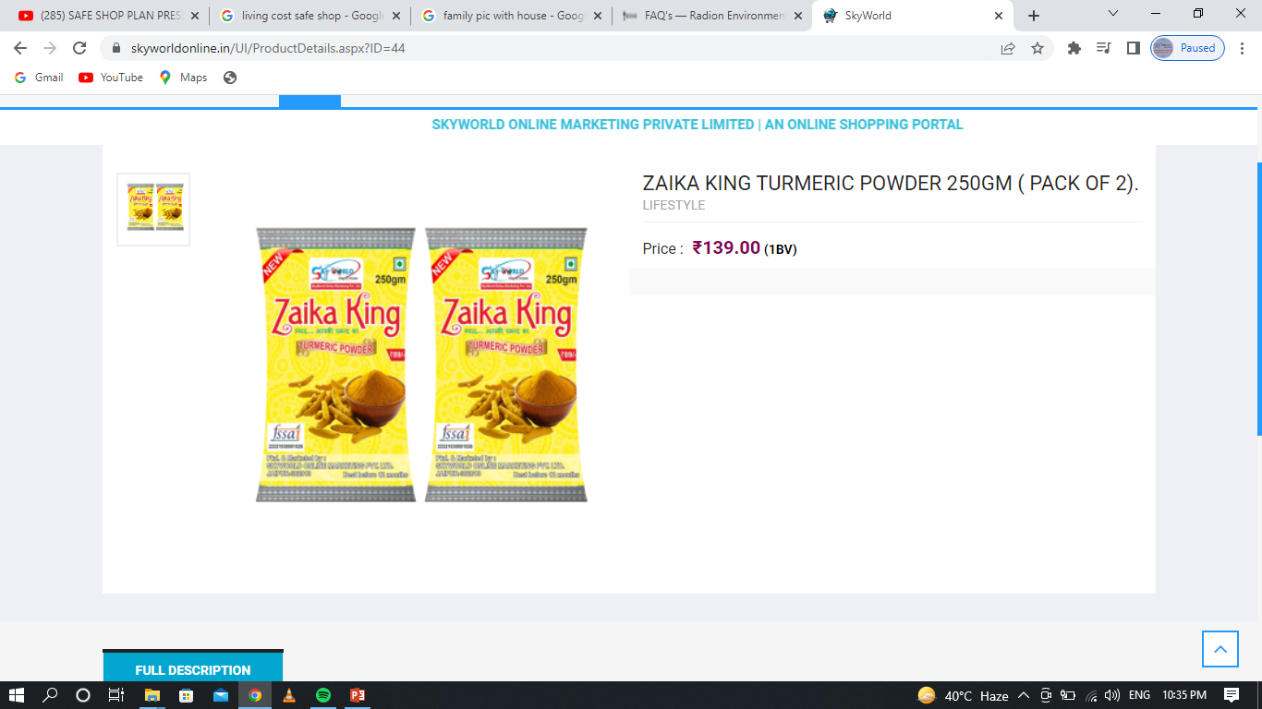
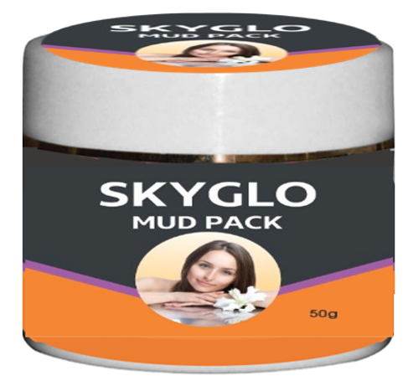
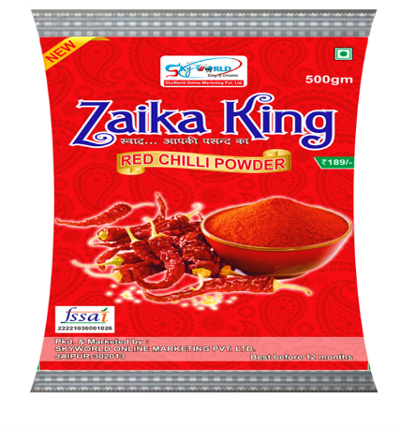
FMCG PRODUCTS
www.myskyworldonline.com

Slide 11
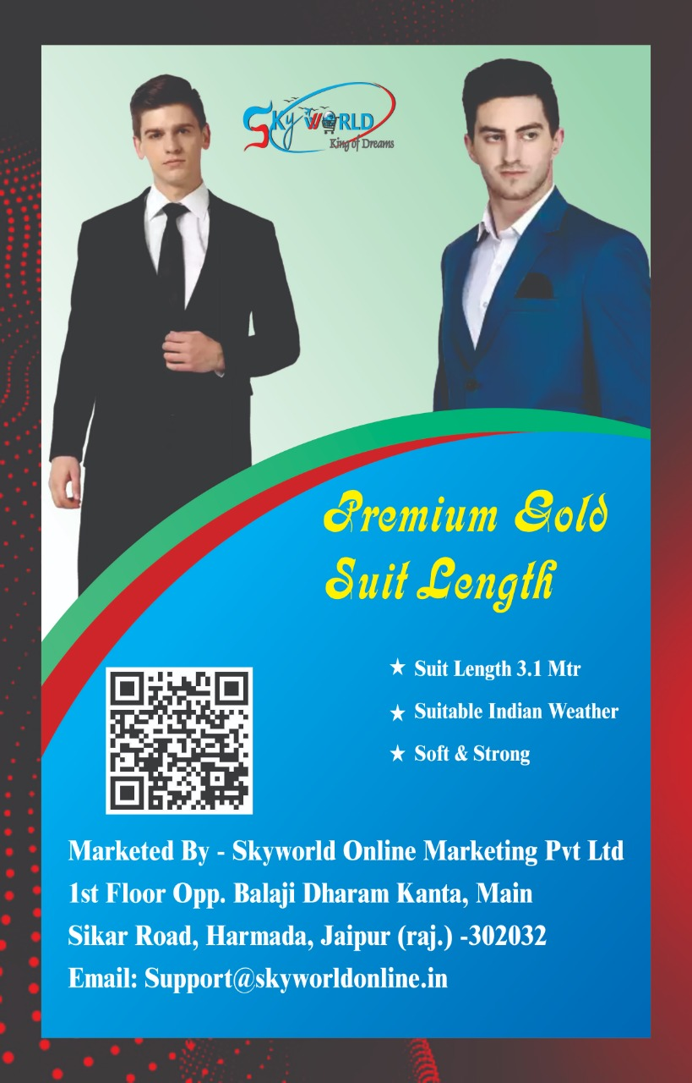
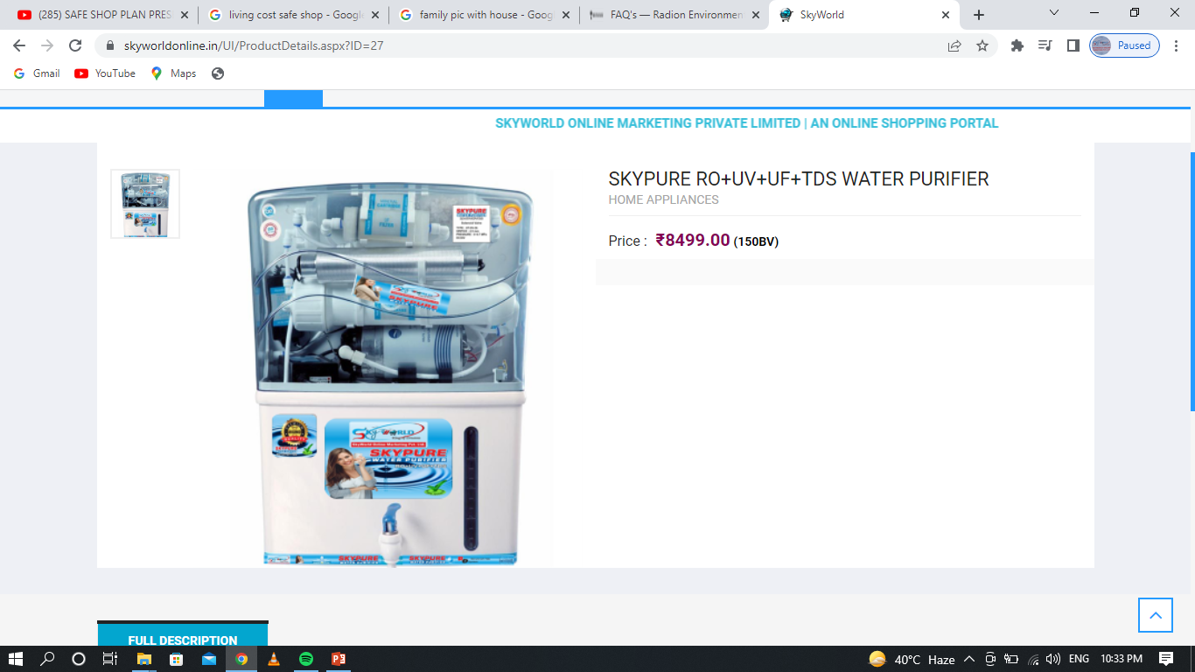
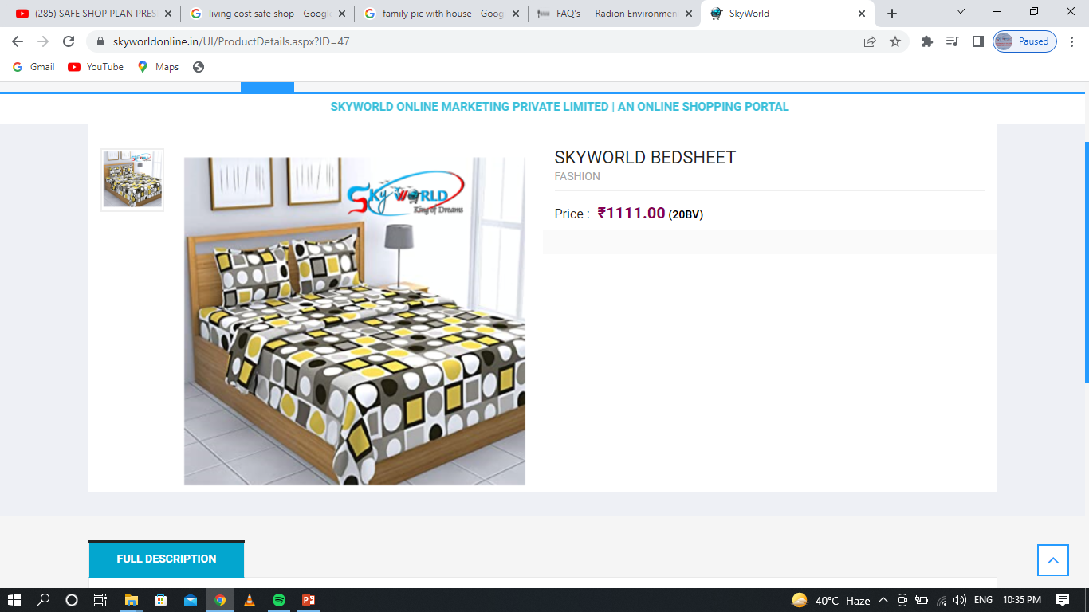
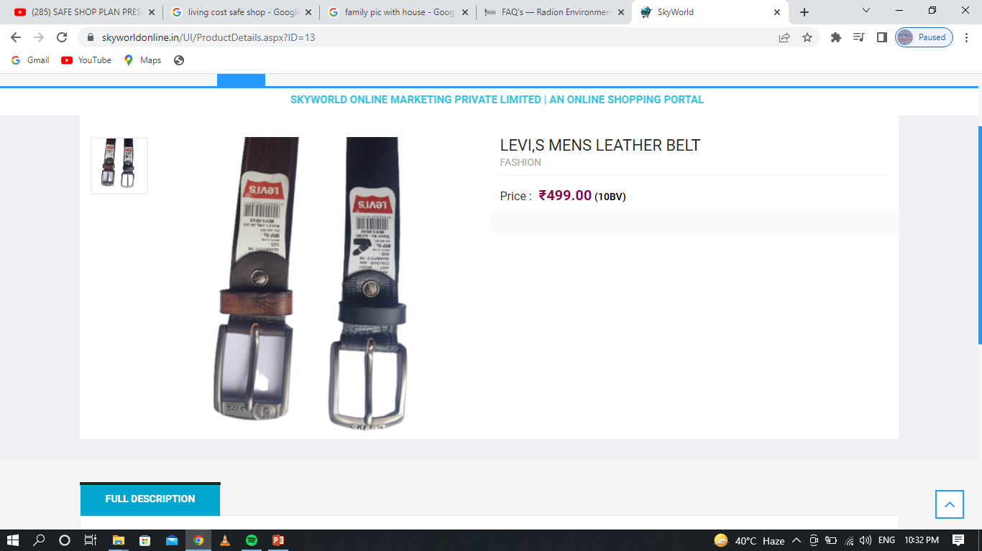
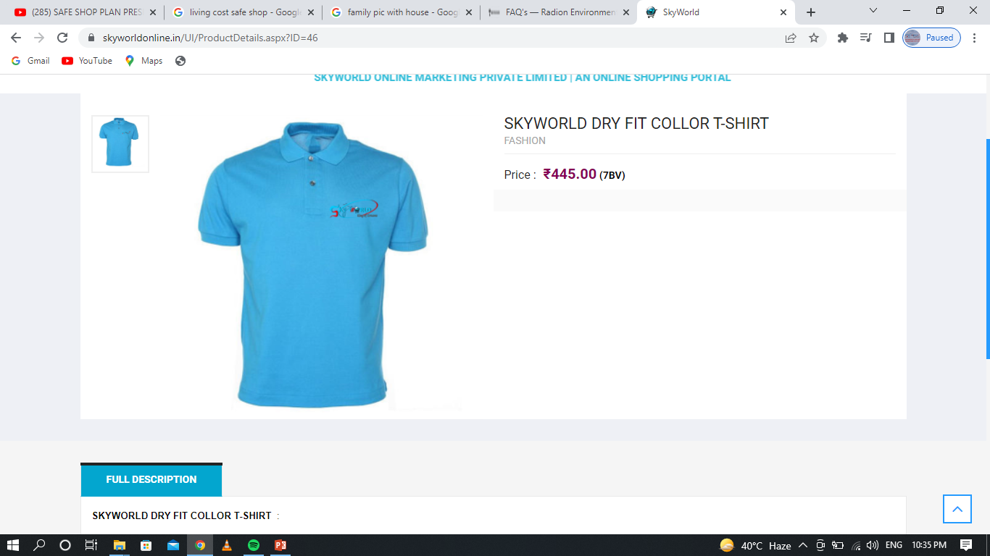
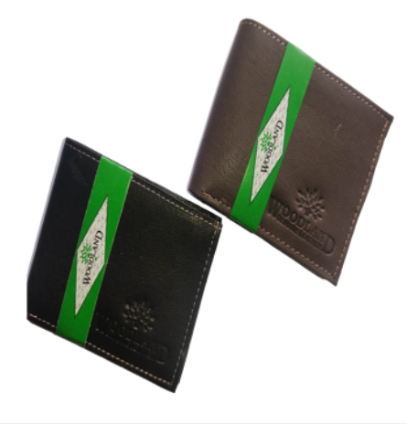
LIFESTYLE
www.myskyworldonline.com

Slide 12
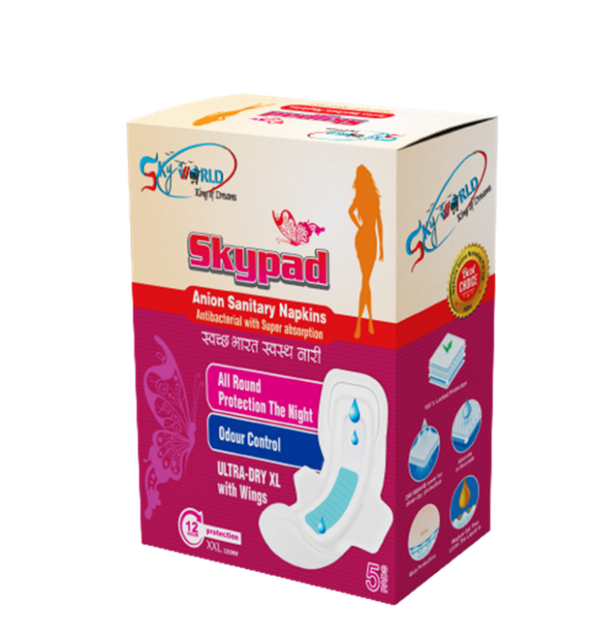
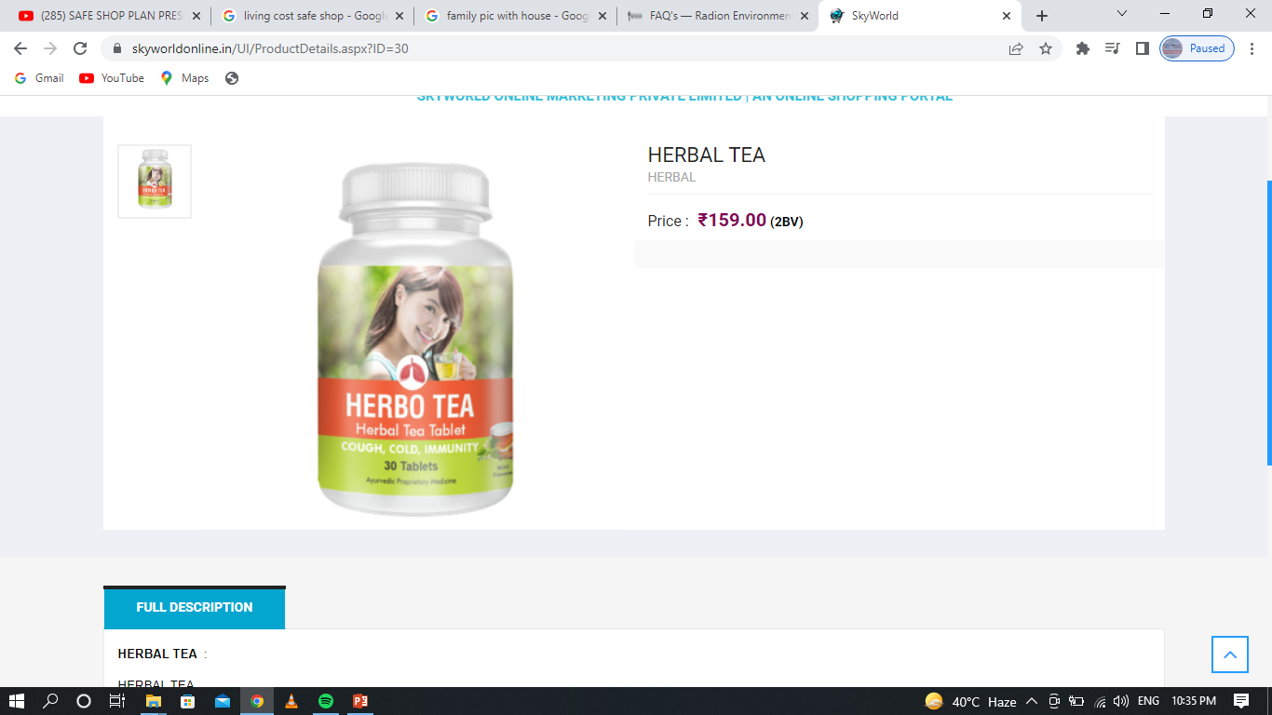
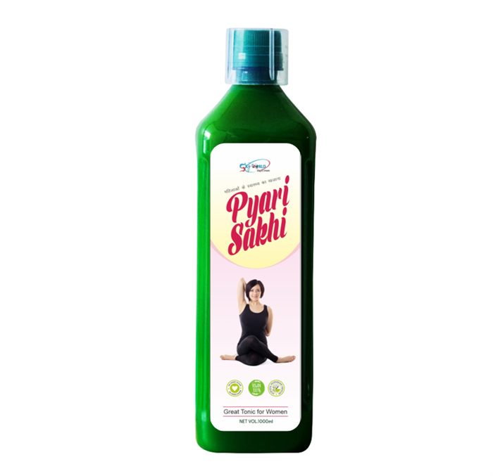
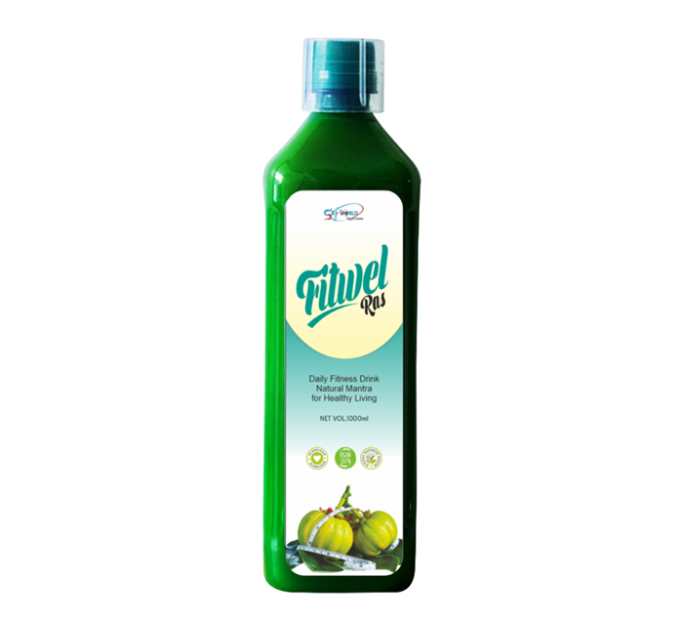
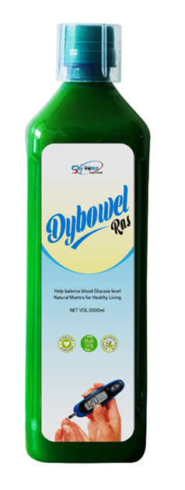

HEALTH PRODUCT
www.myskyworldonline.com

Slide 13

UNLIMITED INCOME
BUSINESS PLAN
www.myskyworldonline.com

Slide 14

10 TYPES OF INCOME & REWARD
  1. RETAIL INCOME
  7. PROMOTION / REWARD
  2. DIRECT SPONSER INCOME
  8. RE-PURCHASE INCOME
  3. PAIR MATCHING INCOME
  9. FAMILY WELFARE FUND
  4. LEVEL REWARD - TOUR
  5. . LEVEL INCOME - BONUS
  10. CHILDREN EDUCATION
  6. CAR / BIKE/LAPTOP FUND
www.myskyworldonline.com

Slide 15


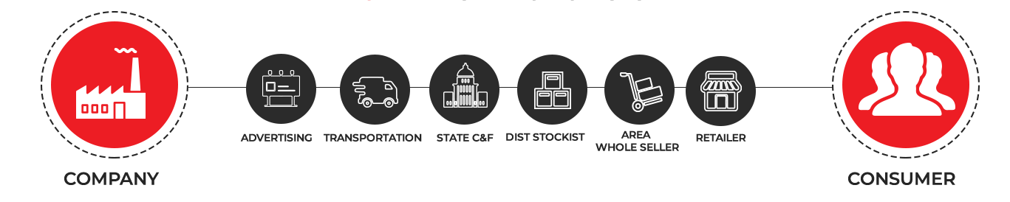

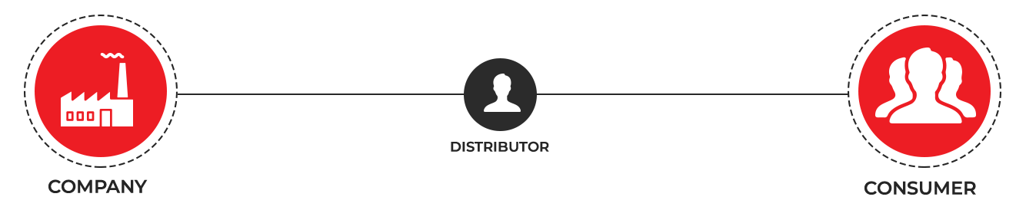
COST - ₹30
MRP -₹100
SKYWORLD
www.myskyworldonline.com

Slide 16
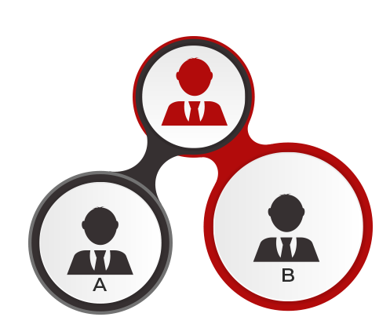
UNLIMITED INCOME
BUSINESS PLAN
DIRECT SPONSER 1BV=₹2
PAIR MATCHING 1BV= ₹2.5
200BV 200BV
DIRECT SPONSER INCOME (200BV + 200BV= 400BV ) 400BV* 2 = ₹ 800
PAIR MATCHING INCOME (200BV + 200BV= 400BV ) 400BV* 2.5 = ₹ 1000
TOTAL INCOME = 800+1000 = ₹1800
www.myskyworldonline.com

Slide 17
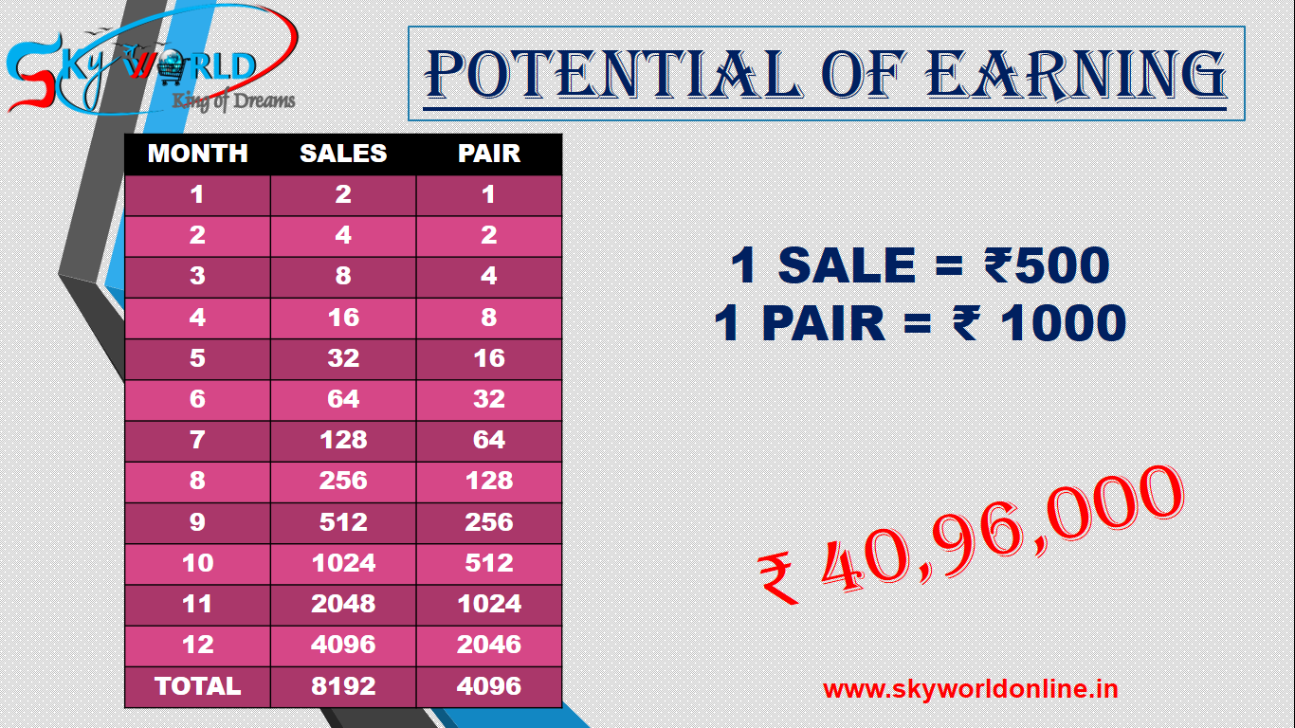
POTENTIAL OF EARNING
1 SALE = ₹500
1 PAIR = ₹ 1000
₹ 40,96,000
www.myskyworldonline.com

Slide 18
RE-PURCHASE INCOME
PAIR MATCHING 1BV= ₹3
200BV 200BV
PAIR MATCHING INCOME (200BV + 200BV= 400BV ) 400BV*3 = ₹ 1200
www.myskyworldonline.com

Slide 19

RECOGNITIONS
S.NO | LEVELS | TOTAL BV | MATCHING INCOME | LEVEL BONOUS | REWARD | TRIP
1 | BRONZE | 600 | ₹1500 | ₹1100 | - | -
2 | SLIVER | 1500 | ₹3750 | ₹2500 | - | -
3 | GOLD | 4800 | ₹12000 | ₹4500 | SMARTWATCH | -
4 | PLATINUM | 12000 | ₹30000 | ₹9000 | ₹5000 LAPTOP | MANALI TRIP
5 | TOPAZ | 30000 | ₹75000 | ₹18000 | ₹20000 BIKE FUND | THAILAND
6 | EMRALD | 75000 | ₹187500 | ₹31000 | - | 4. PAX GOA
7 | SPPAIRE | 150000 | ₹375000 | ₹51000 | - | MALAYSIA
8 | RUBY | 270000 | ₹675000 | ₹100000 | - | DUBAI
9 | OPAL | 360000 | ₹900000 | ₹151000 | - | VIETNAM
10 | DIAMOND | 500000 | ₹1250000 | ₹251000 | 3LAKH CAR FUND | COUPLE BALI
 |  | TOTAL | ₹35,09,750 | ₹6,19,100 | ₹3,27,500 | ₹5,00,000
www.myskyworldonline.com

Slide 20
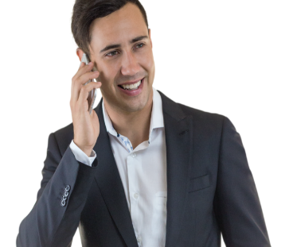
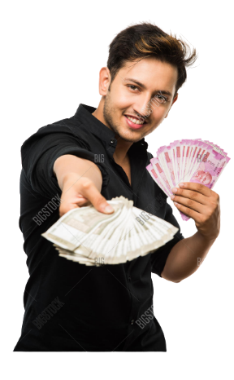
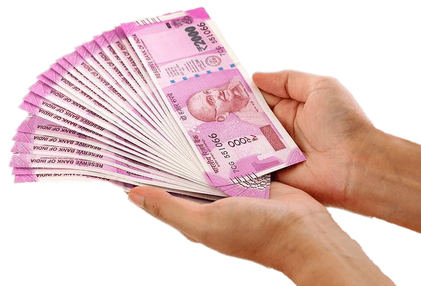
Business week
from
Thursday TO Wednesday
Receive Your income
on next
Wednesday
www.myskyworldonline.com

Slide 21
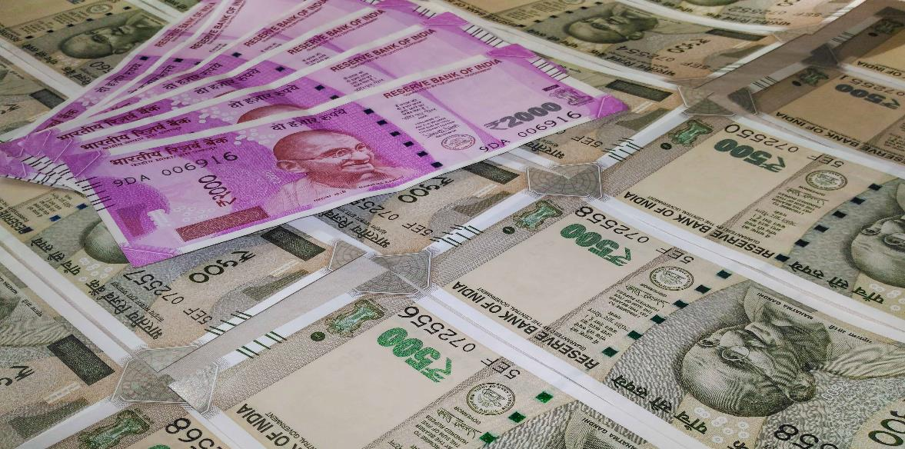

CAPPING PAYOUT
Joining 50 BV - ₹,25,000/Week
Joining 100 BV - ₹,50,000/Week
Joining 200 BV - ₹,100,000/Week
IN REPURCHASE ₹1,50,000/WEEKLY
www.myskyworldonline.com

Slide 22
CAPPING PAYOUT
(PURCHASE + RE-PURCHASE)
PER WEEK 2.5 LAKHS
PER MONTH 10 LAKH
PER YEAR UPTO 1.3 CRORE
www.myskyworldonline.com

Slide 23

NETWORK MARKETING
TRADITIONAL MARKETING
YEAR | YOUR WORK | YOUR TEAM
1 | 10 | 10
2 | 10×10 | 100
3 | 100×10 | 1000
4 | 1000×10 | 10,000
YEAR | YOUR WORK | YOUR INCOME
1 | 8HRS×30 DAYS | 30000 MONTHLY / AVERAGE INCOME 400000/- PER ANNUM
2 | 8HRS×30 DAYS | 400000/- PER ANNUM
3 | 8HRS×30 DAYS | 400000/- PER ANNUM
4 | 8HRS×30 DAYS | 400000/- PER ANNUM
TOTAL INCOME - ₹50,00,000 & ABOVE
TOTAL INCOME - ₹16,00,000 /- ONLY
www.myskyworldonline.com

Slide 24


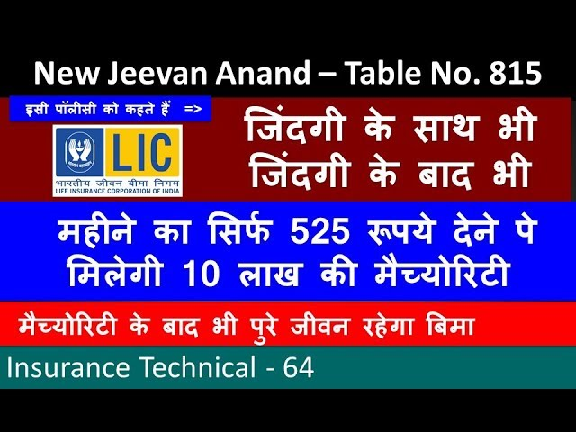

SKYWORLD FAMILY WELFARE FUND
Applicable From Emrald To Diamond Level
LEVEL | AMOUNT
EMRALD | ₹ 1 LAKH
SPPAIRE | ₹ 2 LAKH
RUBY | ₹ 3 LAKH
OPAL | ₹ 4 LAKH
DIAMOND | ₹ 6 LAKH
As Well As Company Also Takes Responsibility For Education Of 2 Children Till Graduation
www.myskyworldonline.com

